Slide 1

FOTO
Seungho Yang, Kevin Trochez, Binbin Xuan, Yun Ye, Gregory Szymanski
Final Presentation

Slide 2
Agenda
Decision
Industry & Company Overview
Business Strategy
Valuation
Questions

Slide 3
Going Private -Gregory Szymanski
We would like a private equity firm to purchase our stock. (a “ take-private” transaction )
Reasons:
Reduced regulatory and reporting requirements
Focus more on improving the business's competitive positioning in the marketplace.

Slide 4
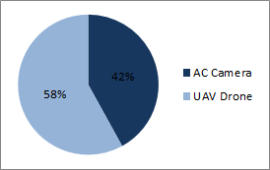
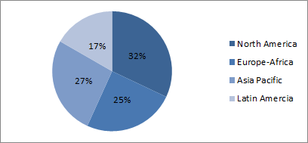
Company Overview - Kevin Trochez
Foto is a world leader in the production of AC cameras and UAV drones.
High quality products for our customers at an affordable price.
Revenue by Product
Revenue by Region

Slide 5
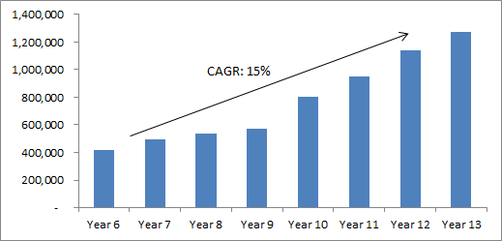
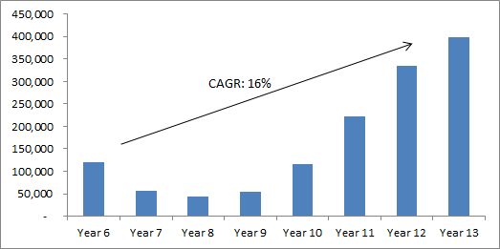
Financial Overview - Kevin Trochez
Revenue Growth
EBITDA Growth
EPS | ROE | Stock Price | Market Cap | Debt/Equity | Dividend Payout
$ 13.60 | 49.70% | $ 400.35 | 7,526,580 | 23:77 | 13.20%

Slide 6
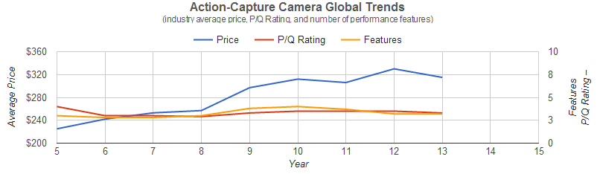
Industry Overview - AC Camera -Yun Ye
Regions | North America | Europe Africa | Asia Pacific | Latin America
AC Camera Demand(units) | 2,196 | 1,812 | 2,100 | 1,494

Slide 7
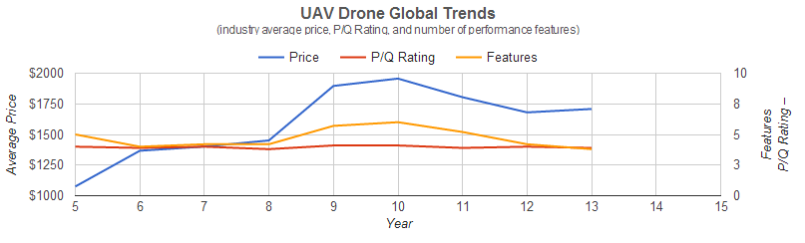
Industry Overview - UAV Drone -Yun Ye
Regions | North America | Europe Africa | Asia Pacific | Latin America
UAV Drone Demand(units) | 588 | 510 | 510 | 300

Slide 8
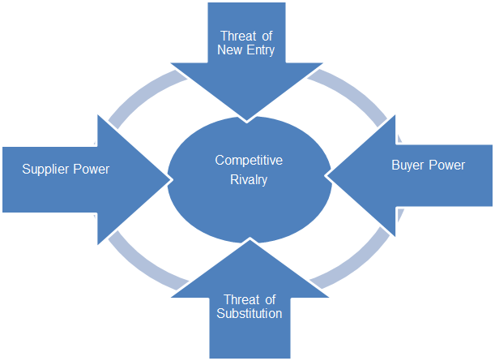
Porter's Five-Forces Model -Yun Ye
Low
-Capital requirement
-Rapidly evolve
-Brand loyalty
High
-Price-sensitive
-Few switch cost
-Undifferentiated
-Online shopping
Low
-Same items and same price
-Low switch cost
-Many small suppliers
High
-Quality of camera on phone
-Traditional cameras

Slide 9
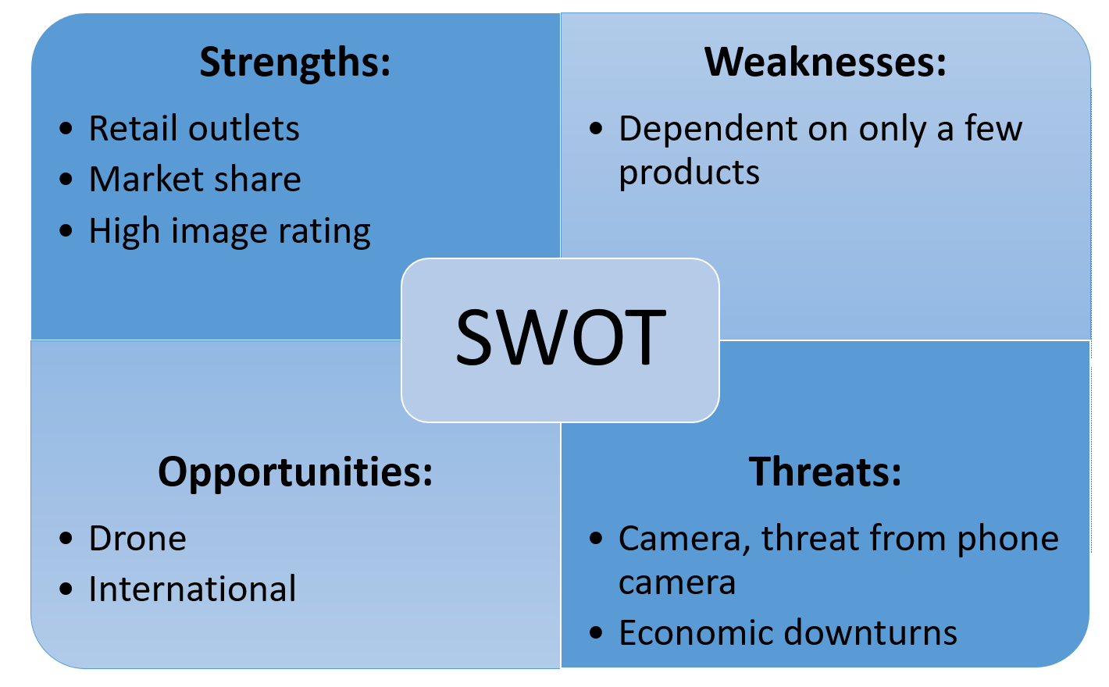
SWOT - Binbin Xuan

Slide 10
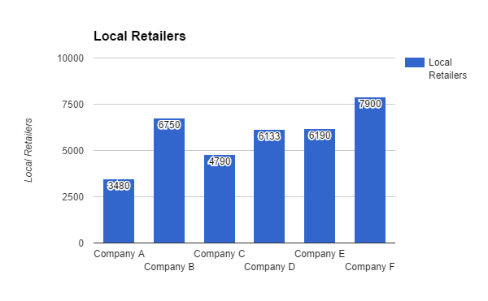
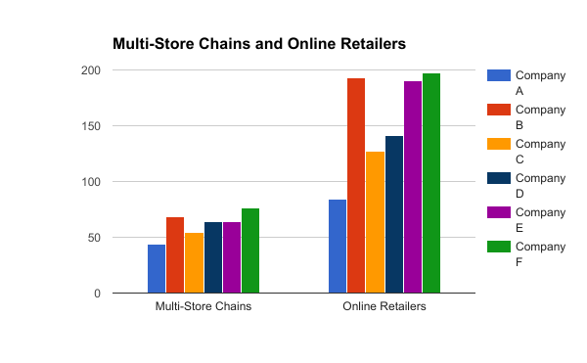
Retail Outlets - Binbin Xuan

Slide 11
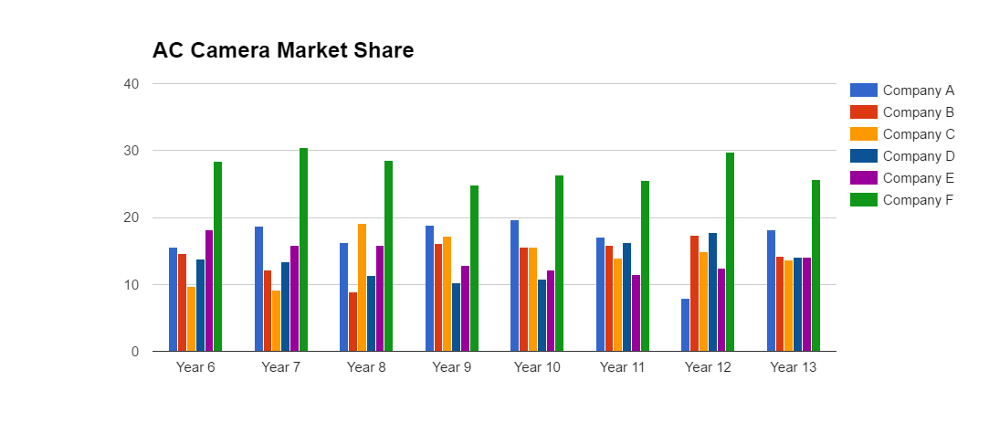
AC Camera Market Share - Binbin Xuan

Slide 12
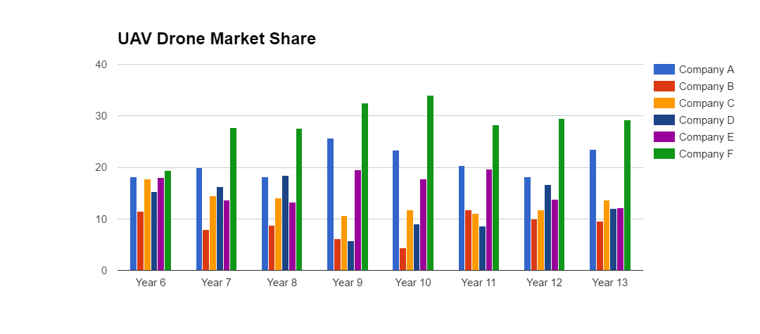
UAV Drone Market Share - Binbin Xuan

Slide 13
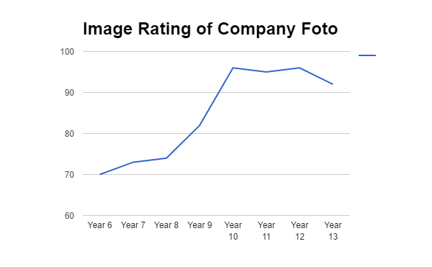
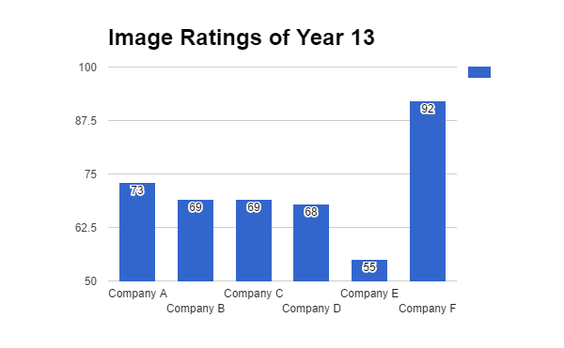
Image Rating - Binbin Xuan
Highest image rating from Year 10-13

Slide 14
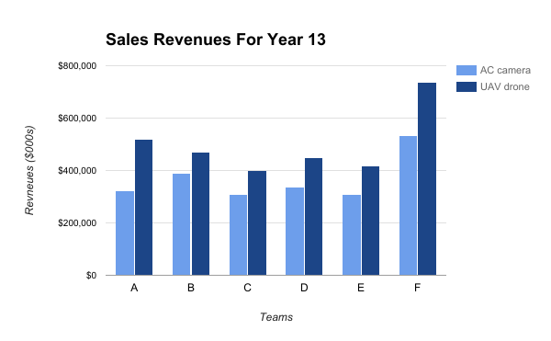
Net Sales Revenue -Yun Ye

Slide 15
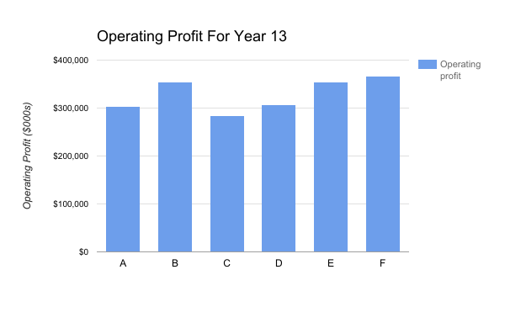
Operating Profit -Yun Ye

Slide 16
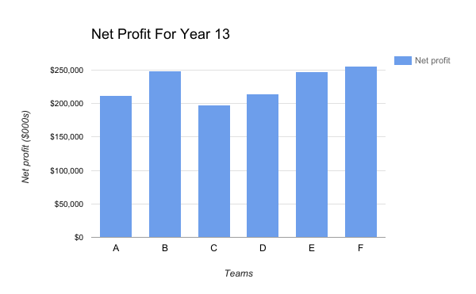
Net Profit -Yun Ye
Company | A | B | C | D | E | F
Net Profit Margin | 25.2% | 28.9% | 27.9% | 27.2% | 34.2% | 20.1%

Slide 17
How did we get these results? -Gregory Szymanski
Long-term strategy
Flexibility
Constant analysis of our rivals

Slide 18
Competitive Advantage -Gregory Szymanski
Combination strategy
Create the best mix of:
Price
P/Q Rating
Number of models
Keep other competition-related factors close to equal

Slide 19
Value Chain -Gregory Szymanski
High Priority Primary Activities:
Operations
Marketing and Sales
High Priority Support Activities:
Technology Development

Slide 20
Key actions -Gregory Szymanski
High R&D investment
Adjust prices accordingly. Stay competitive.
Sacrifice early earnings
Focus on company’s expansion rather than investor expectations

Slide 21
Why R&D? -Gregory Szymanski
R&D provides many benefits:
Reduces the costs of components and accessories.
Increases company’s camera/drone P/Q ratings.
Gradually improves productivity.
Reduces warranty claims and costs.

Slide 22
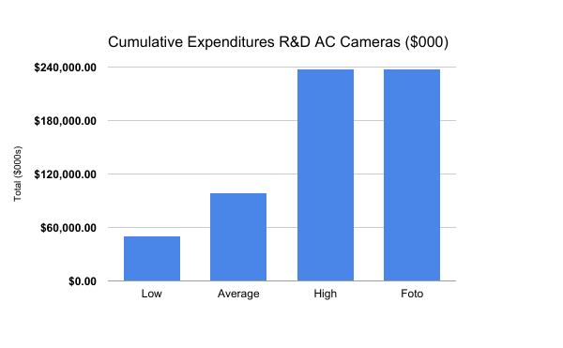
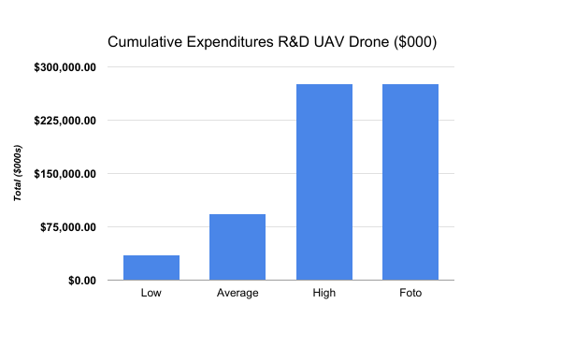
R&D Expenditures Year 13 -Gregory Szymanski

Slide 23
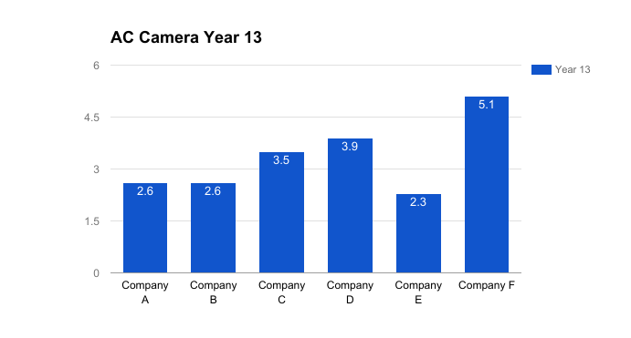
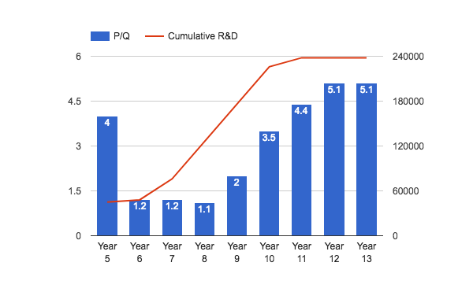
Higher P/Q rating - Seungho Yang
We offer higher quality products.
AC Camera (P/Q and R&D)
AC Camera Yr 13 (P/Q)
Notes:
1.2 points higher than second highest company

Slide 24
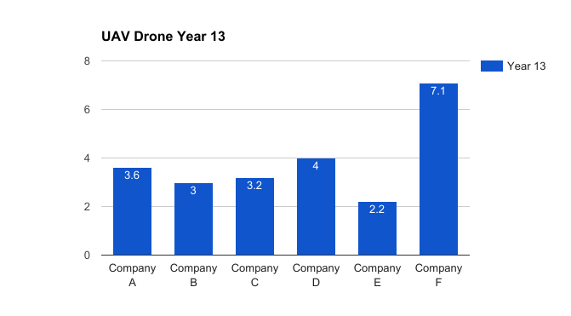
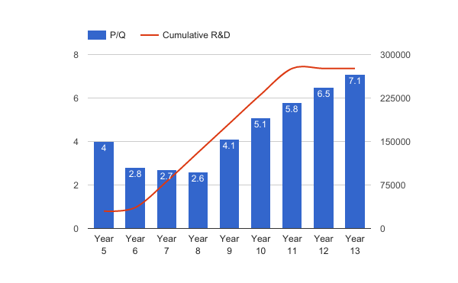
Higher P/Q rating - Seungho Yang
UV Drone Change (P/Q and R&D)
UV Drone Yr 13 (P/Q)

Slide 25
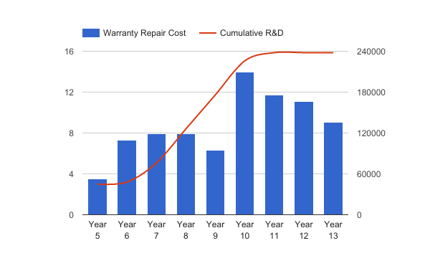
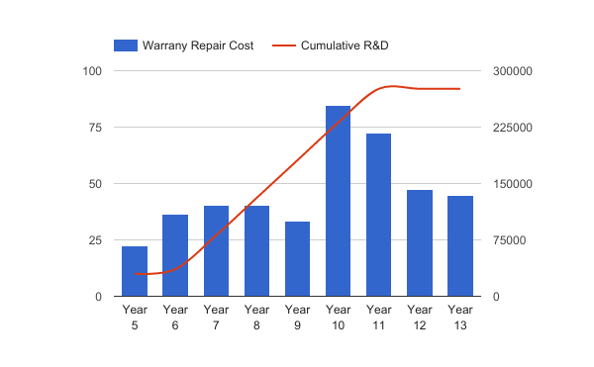
Lower Warranty Costs - Seungho Yang
Reduced warranty claim rate
Increased wages and training were another reason of lower costs
AC Camera Warranty Repair Cost (per unit sold)
UAV Drone Warranty Repair Cost (per unit sold)
Notes:
Reduced claim rate & warranty cost through RD
Ac camera : Yr 10-13 warranty claim rate reduced
Increased wage -> better labor performance

Slide 26
Stable Production Cost - Seungho Yang
Production cost in year 13 is lower than the first year even with higher P/Q rating.
AC Camera Production Cost
Year 5 | Year 13
156.97 | 143.50
UAV Drone Production Cost
Year 5 | Year 13
806.22 | 783.43
P/Q Rating
P/Q Rating
Year 13
5.1
Year 13
7.1
Year 5
4.0
Year 5
4.0
Notes:
Year 5 pq rating : 2.6
Year 13 pq : 5.1
Normally if we lower the producton cost, p/q rating goes down. However thanks to R&D, we could achieve even higher P/Q rating in both products

Slide 27
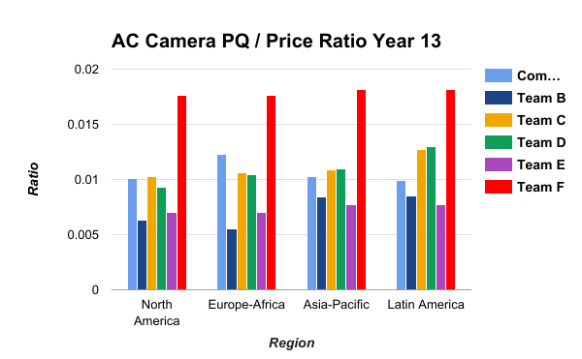
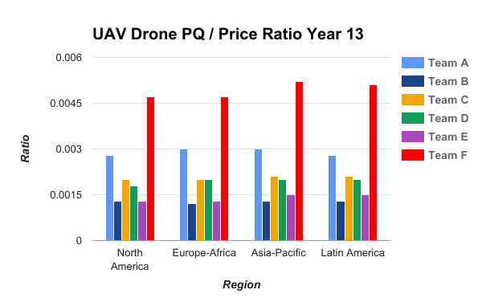
Price & Quality - Gregory Szymanski
How much “value” are you getting per dollar?

Slide 28
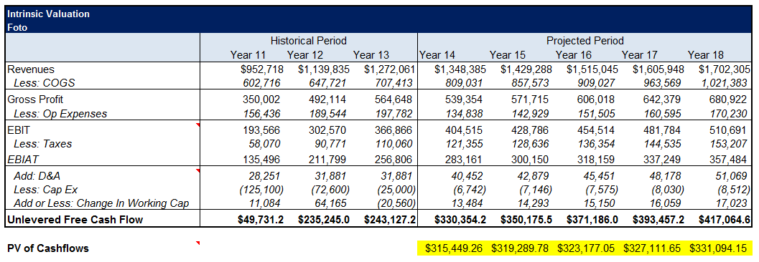
Valuation - DCF - Kevin Trochez

Slide 29
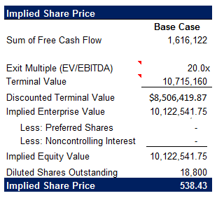
Valuation - DCF - Kevin Trochez

Slide 30
Thank You
Q&A

Slide 31
Questions
What would you change to achieve better early results?
Was keeping marketing cost high at the beginning reasonable?
Why is your EPS and ROE lower than some of your competition?
What does a private equity company gain from buying your stock?

